Slide 1
Advanced Systems Analysis and Design Project Selection and Management SOFT 30121 L3

Slide 2

Project Selection and Management
RecoSystems Analysis and Design
Alan Dennis; Barbara Haley Wixom; Roberta M. Roth
2019
Chapter 2

Slide 3
Project Selection and Management
Objectives of Lecture 3
Explain how projects are selected in some organizations.
Describe various approaches to the systems development life cycle (SDLC) that can be used to structure a development project.
Explain how to select a project methodology based on project characteristics.
Become familiar with project estimation.
Be able to create a project work plan.
Describe project staffing issues and concerns.
Describe and apply techniques to coordinate and manage the project.
Explain how to manage risk on the project
SOURCE: RecoSystems Analysis and Design
Alan Dennis; Barbara Haley Wixom; Roberta M. Roth
2019
Chapter 2

Slide 4

Why project selection and management are important?
Corporate IT departments need to carefully prioritise, select and manage their portfolio of development projects
It is the chief information officers (CIOs) responsibility to select projects that will provide the highest possible return on investments.
Project portfolio management is the process of selecting, prioritising and managing project results. Software solutions such as Prosight and Project.net have become a valuable tool for organisations with many potential projects.
Project managers are responsible for managing and coordinating the tasks and roles, this is often made difficult by demanding stakeholders!

Slide 5
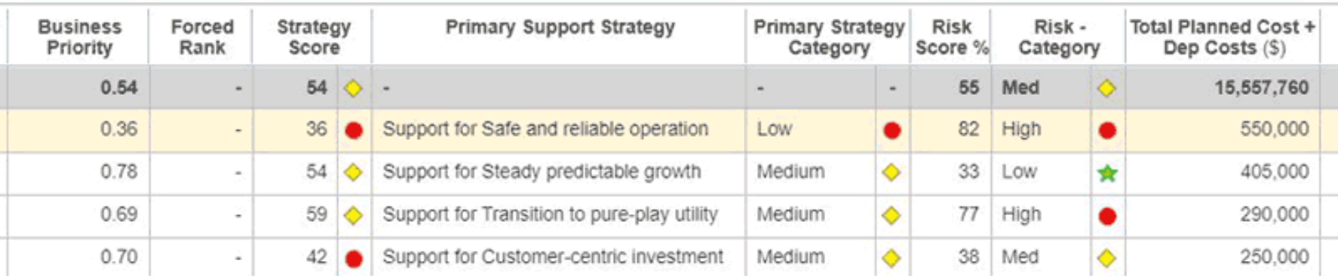
Project Selection
The initiatives managed by the IT steering committee in an organisation are known as the program
These might include the software applications under development, new business models, new technical infrastructures etc.
The steering committee evaluate the costs, benefits, and risks associated with the project.
This is done in the context of the project portfolio as a whole, the committee might want to avoid too many high risk projects for example.
SOURCE: RecoSystems Analysis and Design
Alan Dennis; Barbara Haley Wixom; Roberta M. Roth
2019
Chapter 2

Slide 6

Classifying projects
Size | What is the size? How many people are needed to work on the project?
Cost | How much will the project cost the organization?
Length | What is the purpose of the project? Is it meant to improve the technical infrastructure? Support a current business strategy? Improve operations? Demonstrate a new innovation?
Risk | How likely is it that the project will succeed or fail?
Scope | How much of the organization is affected by the system? A department? A division? The entire corporation?
Economic Value | How much money does the organization expect to receive in return for the amount the project costs?
SOURCE: RecoSystems Analysis and Design
Alan Dennis; Barbara Haley Wixom; Roberta M. Roth
2019
Chapter 1

Slide 7
Creating the Project Plan
The 6 things to consider when choosing a project methodology:
Clarity of User Requirements How well do the users and analysts understand the functions and capabilities needed from the new system?
Familiarity with Technology How much experience does the project team have with the technology that will be used?
System Complexity How much complexity is anticipated in the new system? Does the new system include a wide array of features? Will the system have to integrate with many existing systems? Does it span multiple organizational units, or even multiple organizations?
System Reliability Will this system need to be highly reliable or is some downtime tolerable?
Short Time Schedules Is the project time frame tight?
Schedule Visibility Are the project sponsors, users, or organizational managers anxious to see progress?
SOURCE: RecoSystems Analysis and Design
Alan Dennis; Barbara Haley Wixom; Roberta M. Roth
2019
Chapter 2

Slide 8
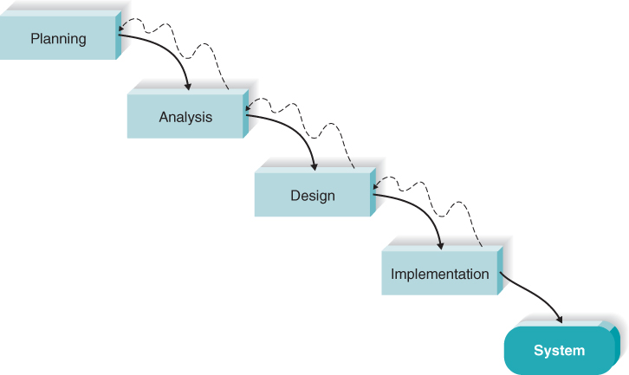
Waterfall development
Requirements are identified before programming begins, and limited as the project progresses
However, a long time elapses between the completion of the proposal and the delivery of the system (causing problems if requirements are missed…)

Slide 9
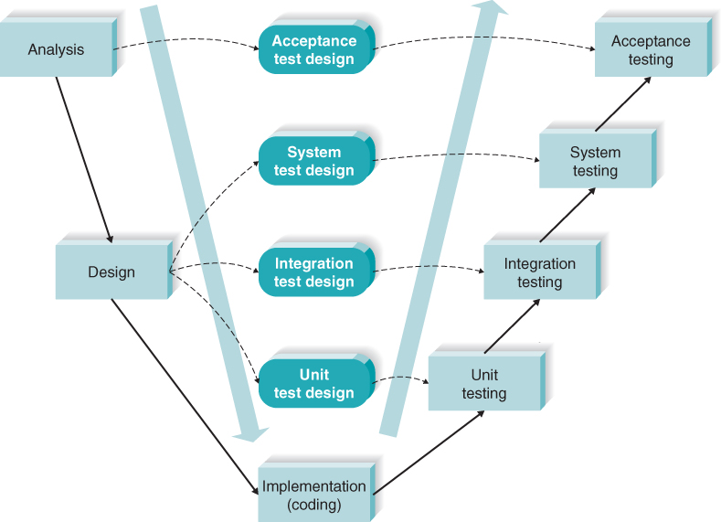
V-Model Waterfall development
Similar to waterfall with more of a focus on testing
As requirements are specified and components designed, testing is also defined.

Slide 10
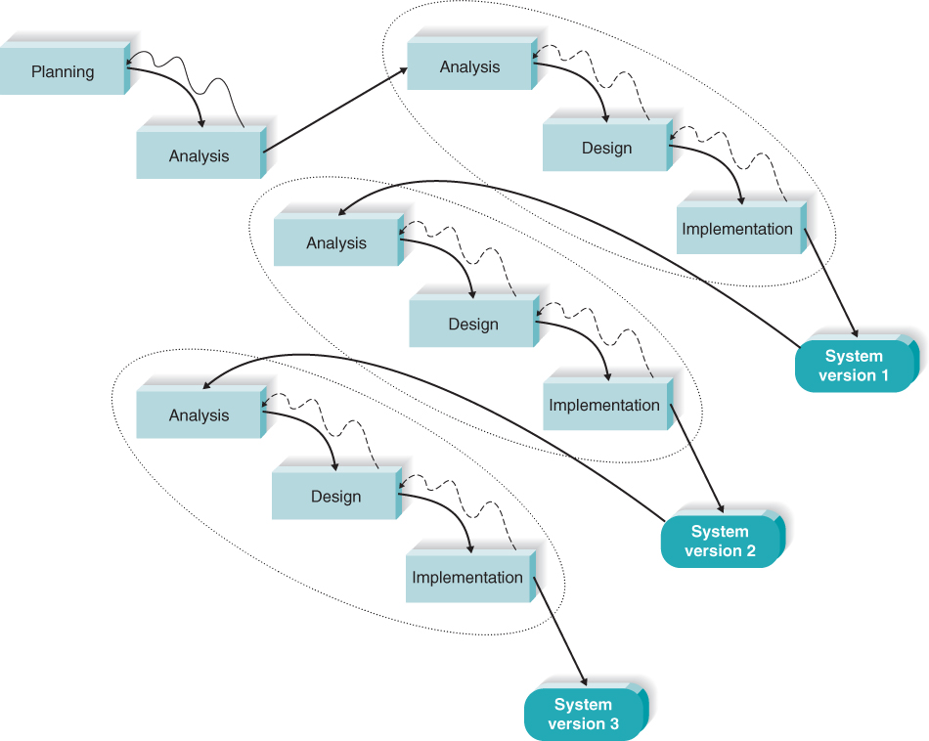
Iterative Rapid Application Development (RAD)
It’s pretty rad
The first version is developed quickly by a mini-waterfall process so users can provide feedback
Important additional requirements can be incorporated into the system

Slide 11
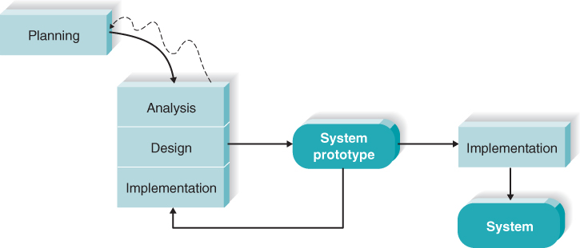
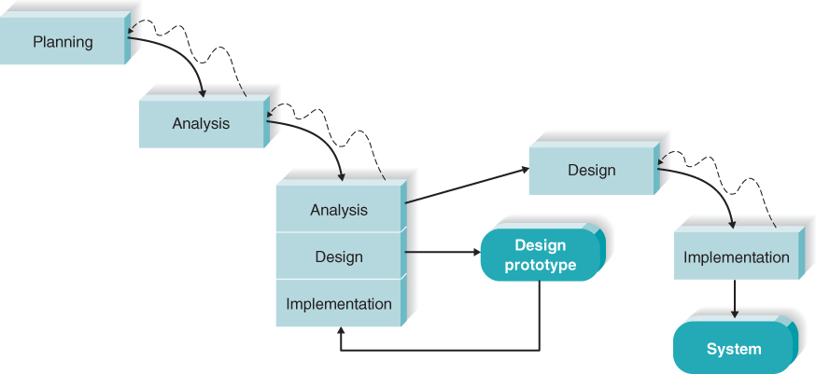
System prototyping
Similar to iterative development, except after the first prototype is developed, the system is reanalysed, redesigned and reimplemented
Uses prototypes to explore design alternatives.
These prototypes are not intended to be a working system, they are a means for users to understand issues under consideration
Throwaway prototyping

Slide 12
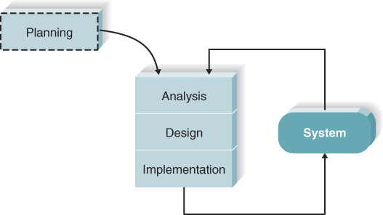
Agile development: Extreme programming (XP)
In Agile development, modelling and documentation is eliminated in favour of face-to-face communication
XP prioritises communication and simple and clean designs.
Developers are able to respond to changing requirements
Be wary of mission critical applications due to lack of documentation

Slide 13
Agile vs Waterfall
Agile practices were created in part because of a dissatisfaction of the inflexible waterfall-based approaches
One isn’t necessarily always better than the other

Slide 14
Selecting the appropriate development methodology
How useful is each methodology when developing systems with…
 | Waterfall | Parallel | V-Model | Iterative | System Prototyping | Throwaway Prototyping | Agile Development
With unclear user requirement | Poor | Poor | Poor | Good | Excellent | Excellent | Excellent
With Unfamiliar technology | Poor | Poor | Poor | Good | Poor | Excellent | Poor
That are complex | Good | Good | Good | Poor | Poor | Excellent | Poor
That are reliable | Good | Good | Excellent | Good | Poor | Excellent | Good
With a short time schedule | Poor | Good | Poor | Excellent | Excellent | Good | Excellent
With schedule visibility | Poor | Poor | Poor | Excellent | Excellent | Good | Good

Slide 15
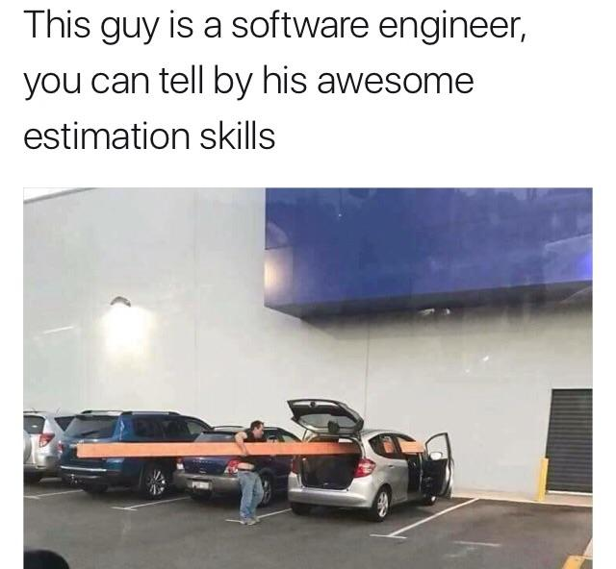
Estimation
The process of assigning projected values for time and effort
Data used to calculate estimates come from a variety of sources. Some development methodologies specify the amount of time each phase should take
Ultimately the most useful way to make estimates is from past experience
Another basic way is to assume the following:
 | Planning | Analysis | Design | Implementation
Typical % effort | 15% | 20% | 35% | 30%

Slide 16
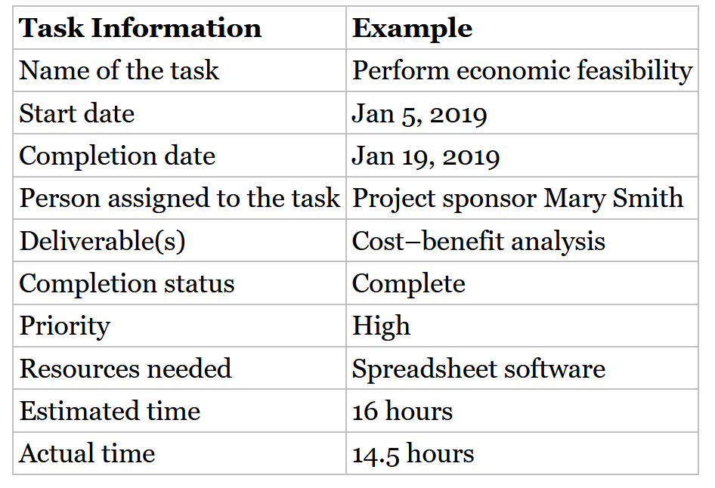
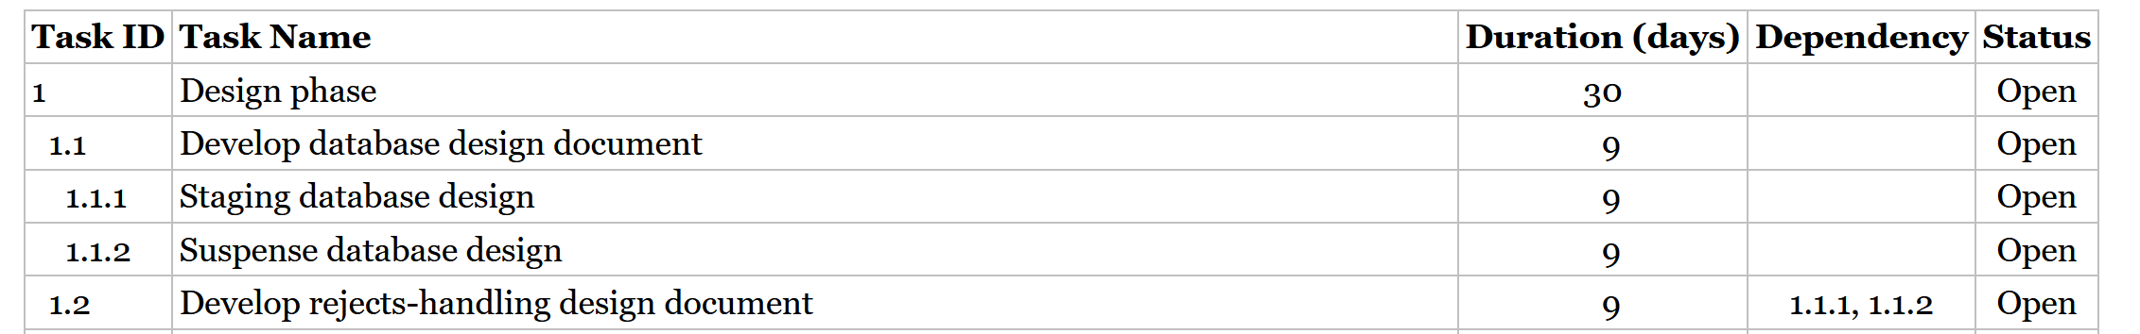
Developing the work plan: Identifying tasks
The work plan is a dynamic schedule that keeps track of all the tasks that need to be accomplished over the course of the project
First step is to identify all the tasks that will be needed to accomplish the system objectives
High-level tasks can be defined first, then broken down into subtasks. This is known as a work breakdown structure

Slide 17
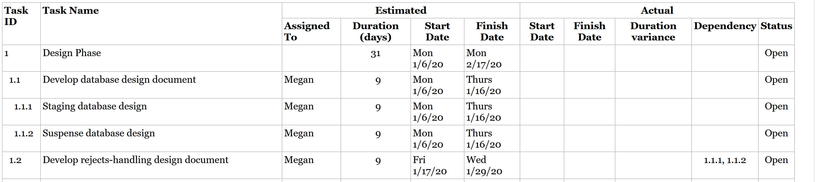
Developing the work plan: The Project Work Plan
Is used to manage the tasks that are listed in the work breakdown structure
At minimum, should include the duration of the task, the current statuses of the tasks, and the task dependencies.

Slide 18
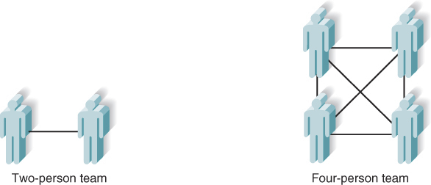
Staffing the project: Team size
Staffing plan: describes the number and kinds of people who will work on the project, the overall reporting structure, and the project’s objective and rules.
Assigning more staff does not necessarily shorten the project’s length! A large number of staff members is more difficult to coordinate
Communication complexity grows dramatically as the number of staff increase:

Slide 19
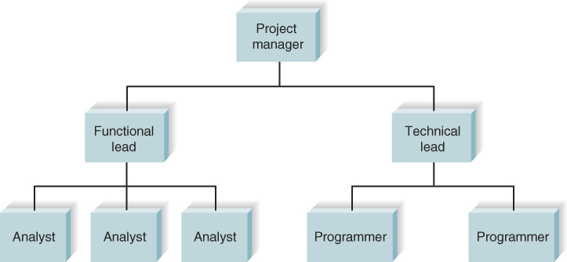
Staffing the project: reporting structure
One way to manage larger numbers of staff is through creating a reporting structure
Communication can be kept effective within each smaller team

Slide 20
Staffing the project: Roles & Motivation
Technical skills and interpersonal skills are key when assigning roles on a project
Motivation has been found to be the number-one influence on people’s performance
Things to avoid when trying to motivate your team:
Don’ts | Reasons
Assign unrealistic deadlines | Few people will work hard if they realize that a deadline is impossible to meet
Ignore good efforts | People will work harder if they feel that their work is appreciated. Often, all it takes is public praise for a job well done.
Create a low-quality product | Few people can be proud of working on a project that is of low quality.
Make an important decision without the team’s input | Buy-in is very important. If the project manager needs to make a decision that greatly affects the members of her team, she should involve them in the decision-making process.

Slide 21
Staffing the project: Handling conflict
Team roles should be clearly defined so team members can be held accountable for their tasks
Some project managers develop a project charter that lists the project’s norms and ground rules. In addition to this, the following can be used to prevent conflict:
Clearly defining plans for the project
Develop detailed operating procedures and communicate these to the team members
Develop schedule commitments ahead of time
Forecast other priorities and their possible impact on the project

Slide 22
Student group project specific advice…
Communication is key! Set up a group chat/teams channel early, and make sure everyone checks it often
Make sure everyone is aware of your other tools such as google sheets, GitHub and work management systems (more on this in the next lecture)
Don’t suffer in silence! If your struggling with something your group has asked you to do, they’ll appreciate it much more if you raise it sooner rather than later

Slide 23
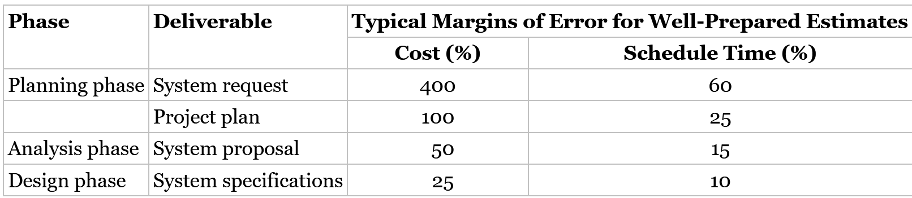
Managing and controlling the project: Refining estimates
Estimates will become more specific as the system becomes better defined
Accuracy and precision increase until the final system is delivered
COCOMO 2.0 assumes that a well-prepared project plan (prepared at the end of the planning phase) has a 100% margin of error for project cost (could be anywhere between zero and double what was estimated), and a 25% margin of error for schedule time.
Typical margins of error for other areas of the project:

Slide 24
Adjusting for future estimates
Normally if the project team finishes ahead of schedule, the project manager will shift deadlines forward, but not adjust the promised completion date
3 main ways to adjust future estimates when the project is behind schedule. These depend on whether you assume the rest of the project is…
Simpler than the part that was late, and is also simpler than what was originally thought: Do not change schedule you can make up lost time
Simpler than the part that was late, but no more complex than the original estimate: Increase the schedule by the amount of time you are behind
More complex than the part that was late: Increase the entire schedule by the percentage of weeks you are behind. If this new date is not acceptable, you will need to reduce the scope of the project

Slide 25

Managing scope: Scope creep
Scope creep happens when new requirements are added to the project after the original project scope was defined. These could be introduced by the users, developers or managers.
This can impact the cost and schedule
This can be avoided by identifying the requirements as well as possible at the beginning
The project manager should only allow necessary requirements to be added after the project begins

Slide 26
Timeboxing
Schedule isn’t always driven by the tasks that need to be completed. Sometimes meeting a deadline take priority over delivering functionality
Timeboxing sets a fixed deadline for a project and delivers the system by this deadline, and reduces functionality if necessary. The steps for this are below:
Set the date for system delivery.
Prioritize the functionality that needs to be included in the system.
Build the core of the system (the functionality ranked as most important).
Postpone functionality that cannot be provided within the time frame.
Deliver the system with core functionality.
Repeat steps 3 through 5, to add refinements and enhancements.

Slide 27
Managing Risk
Risk management is the process of assessing and addressing the risks that are associated with developing a project.
It’s important to be aware of these in the planning phase so they can be avoided well ahead of time
A risk assessment is often produced documenting the likelihood of the risk, the potential impact on the project, and ways to address the risk.

Slide 28
Example risk assessment:
RISK #1:
The development of this system likely will be slowed considerably because project team members have not programmed in Java prior to this project.
Likelihood of risk:
High probability of risk
Potential impact on the project:
This risk likely will increase the time to complete programming tasks by 50%.
Ways to address this risk:
It is very important that time and resources are allocated to up-front training in Java for the programmers who are used for this project. Adequate training will reduce the initial learning curve for Java when programming begins.

Slide 29
Next Lecture
Work Management Systems

